Slide 1
FOOD_CROP_PRODUCTION
IN
INDIA

Slide 2
OBJECTIVE
This Presentation shows different crop production of different states in India by using features of Python tool
I have used Pandas, Matplotlib & Seaborn

Slide 3
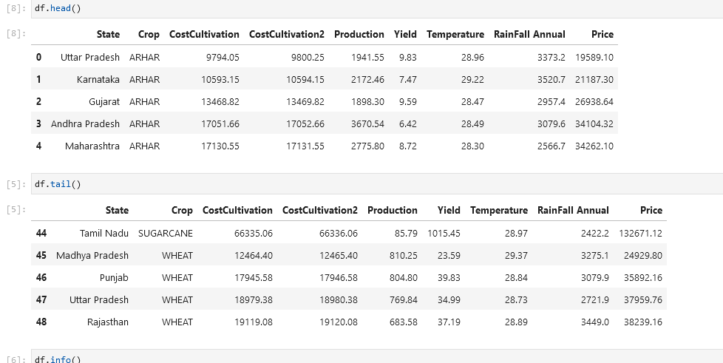
FOOD CROPS PRODUCTION DATASET

Slide 4
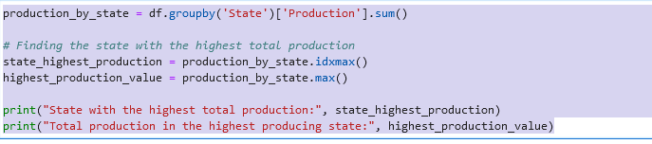

State with the highest total crop production in overall
I have used the group by for the state column and summed up the value of the production in each state
It is stored in the variable “Production_by_state”
production_by_state.idxmax() ~ this code corresponds to the state with the highest total production.
production_by_state.max() ~ this code corresponds to the highest total production among the states
AP:- Arhar: 3670, Cotton: 2509, Gram:1559, Groundnut:2554, Maize:840, Moong:2228, Paddy:789, Sugarcane:120

Slide 5
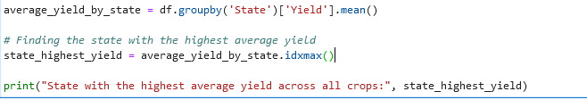
Yield is the amount of a specific crop that is harvested per unit area of land.
State with the highest average yield
I have used the group by for the state column
Calculated the mean of the yield for each state
average_yield_by_state.idxmax() ~ finds the index of the state where the average of yield is highest
Print the state with highest average yield

Slide 6
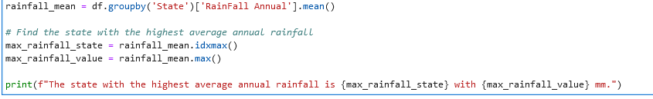
State has the highest average annual rainfall
I have used the group by for the state column
Calculated the mean of the rainfall for each state
rainfall_mean.idxmax()~ finds the index of the state where the rainfall is highest
Print the state with highest average annual rainfall

Slide 7
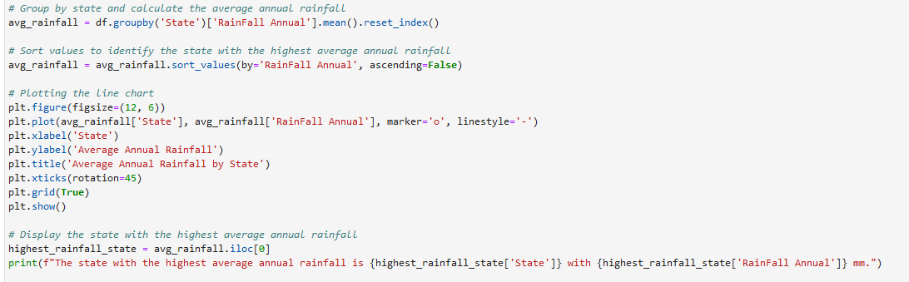
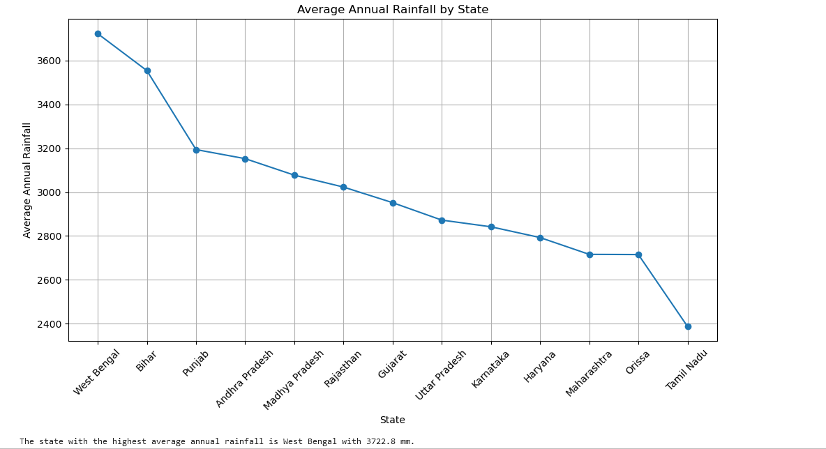
Virtual presentation of highest annual rainfall
West Bengal has the highest annual rainfall and Tamil Nadu has the least annual rainfall

Slide 8
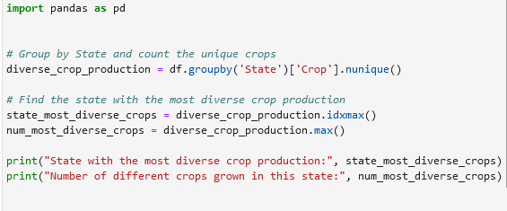
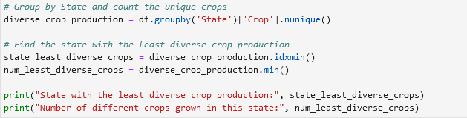

State with the most/least diverse crop production
AP: Arhar, Cotton Gram, Groundnut, Maize, Moong, Paddy, Sugarcane
Bihar: Maize

Slide 9

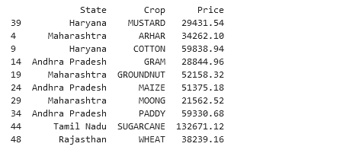
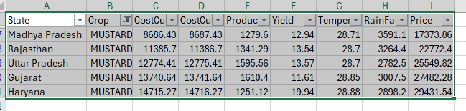
State with the highest price for each crop
Mustard is grown in different states (MP, UP, Gujarat, Haryana, Rajasthan, however price is very high in Haryana

Slide 10
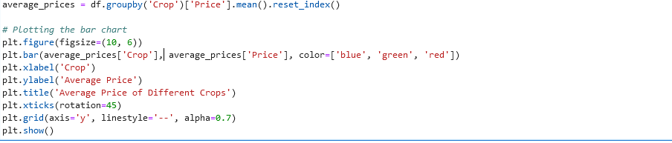
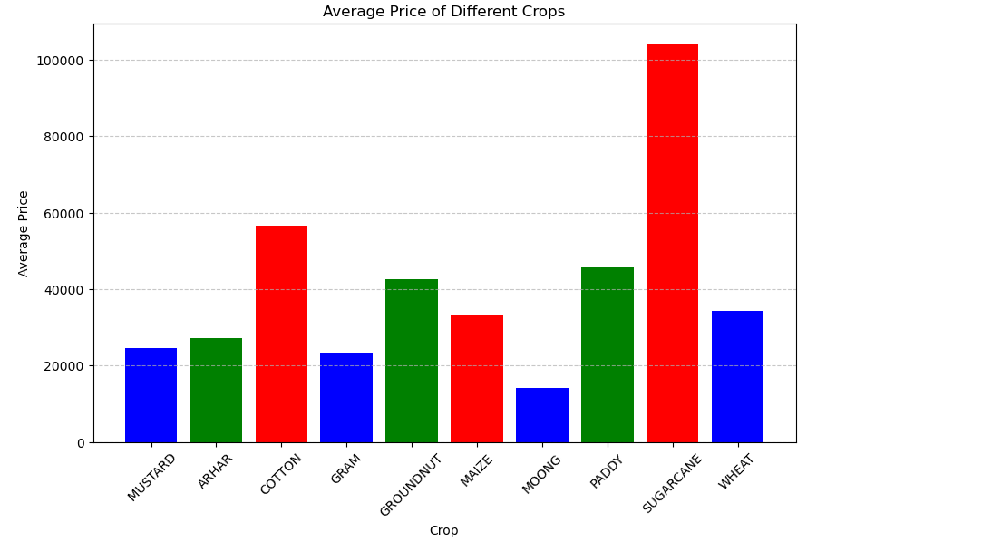
Crop with the highest average price across all states
Among all the crops, sugar cane has the highest average price

Slide 11
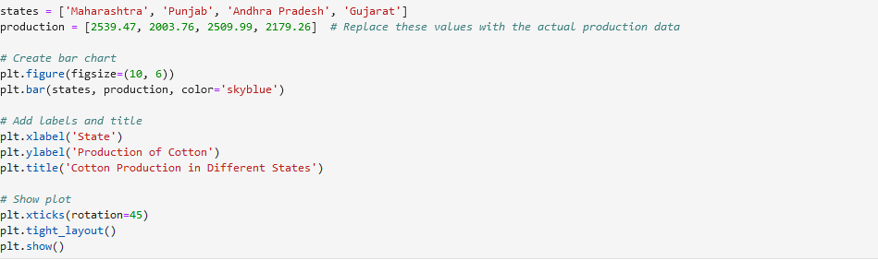
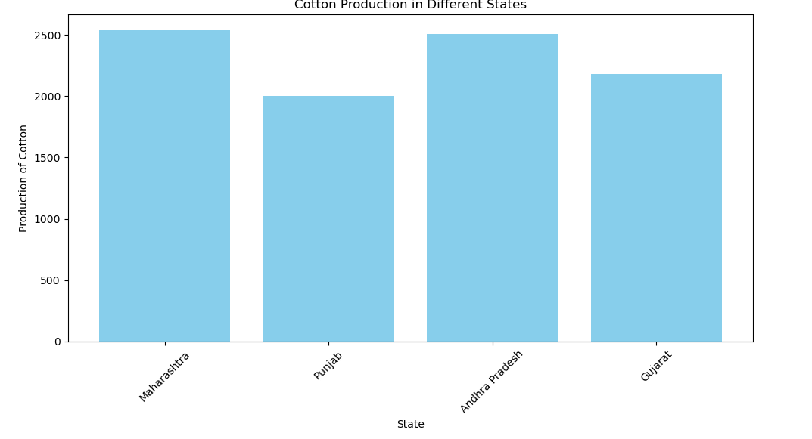
Cotton PRODUCTION IN DIFFERENT STATES

Slide 12
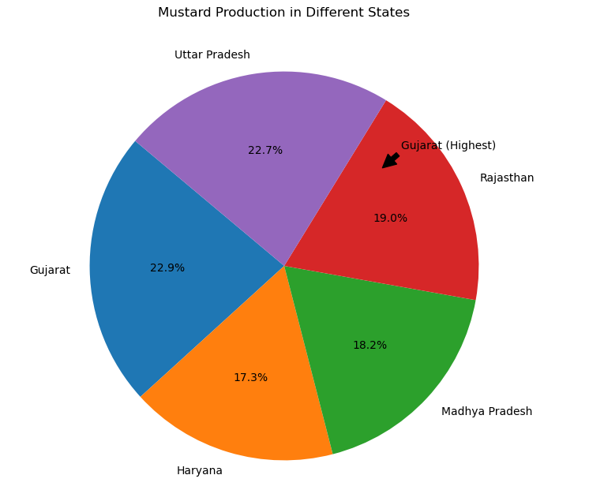
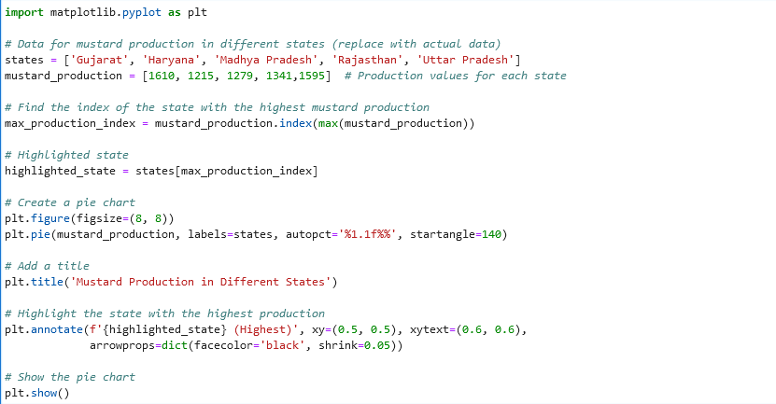
MUSTARD PRODUCTION IN DIFFERENT STATES

Slide 13
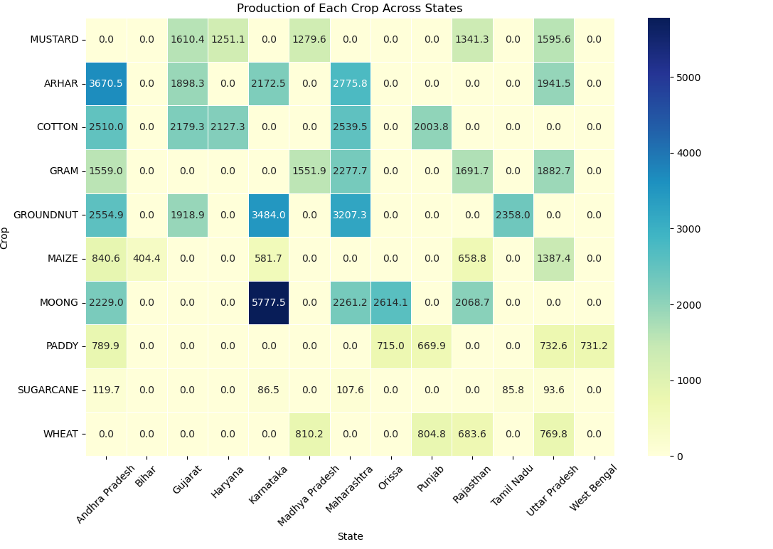
Comparison of production of each crop across all the states

Slide 14
THANK YOU

